Slide 1








SARKARI RESULT
By KSD Groups

Slide 2
INTRODUCTION
Our Mini Projects is Clone of Sarkari Result(Government). The Purpose of this Projects is Job Oriented form and Government exam information and Results.
Our member are:-
Krishna Chandra Upadhyay(coder)
Dheeraj Yadav(Tester)
Sanjeet Singh(Idea Implementer)

Slide 3
2. PROJECT GOALS
1.
We made this website for Job Oriented application , Government exams and result declaration.
2.
To make this website alternate of the parent website i.e. Sarkari Result
in case to reduce the traffic on the parent website.

Slide 4
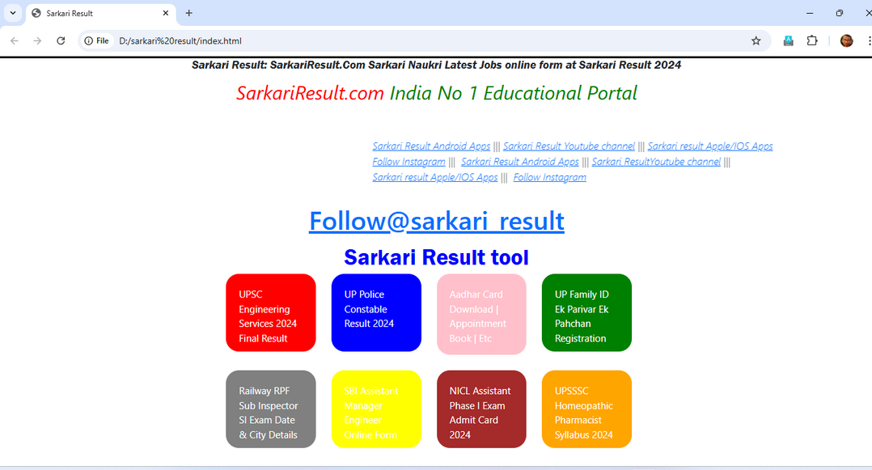
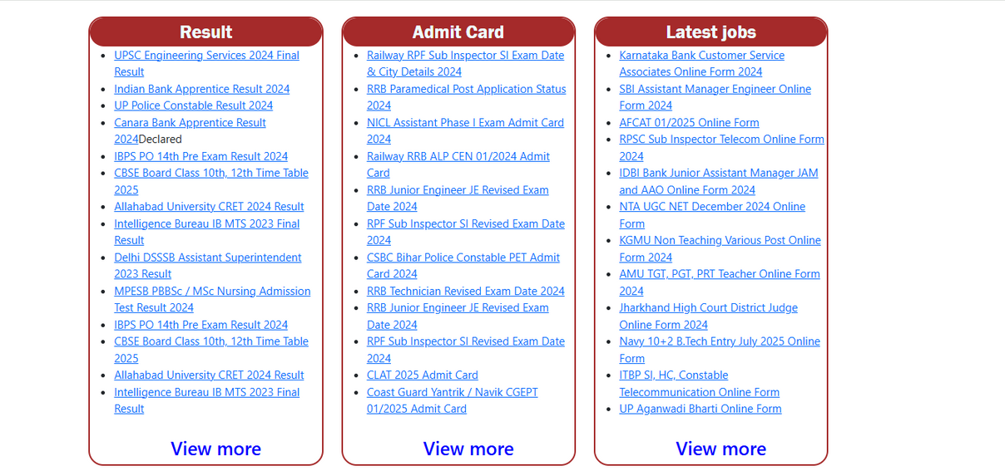
SCREENSHOT AND WOKING
HOME PAGE
HOME PAGE

Slide 5
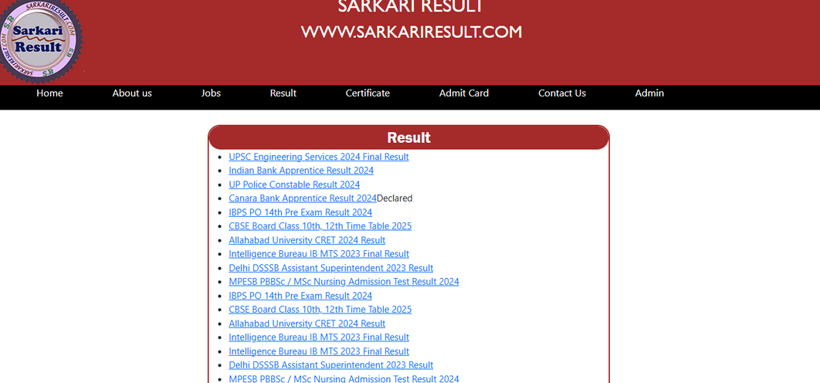
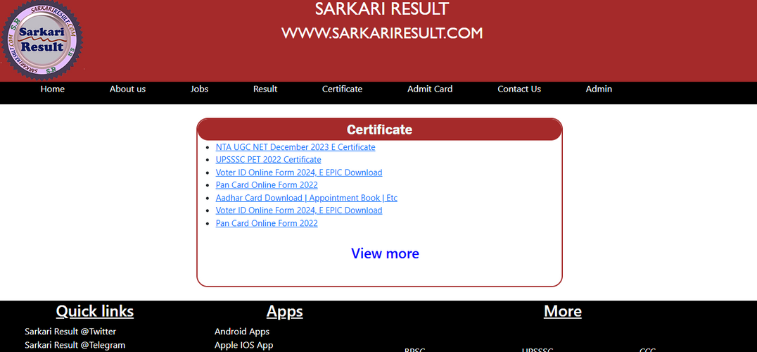
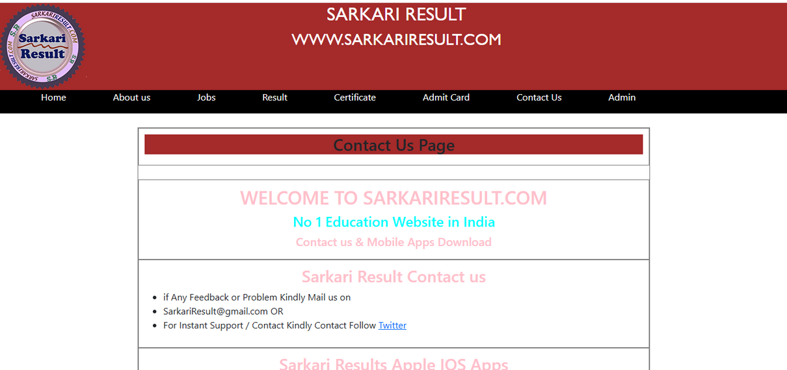
RESULT PAGE
CERTIFICATE PAGE
CONTACT PAGE

Slide 6
4. FUTURE SCOPE
It can be Total Dynamic Websites in future.
Giving Notification to user.
personal assistance.
Exam preparation resources.
Career counseling.

Slide 7
CONCLUSION
The "clone" of a popular site like Sarkari Result may seem convenient both in terms of security and reliability.

Slide 8

THANK YOU

